Slide 1
Welcome to the Royal Alexandra and Albert School Sixth Form Open Evening

Slide 2
Headmaster
Mark Dixon

Slide 3
The Sixth Form
We develop impressive individuals ready to flourish
Providing an inclusive and all-round education
Delivering academic progress and success
Inspiring leadership and character

Slide 4
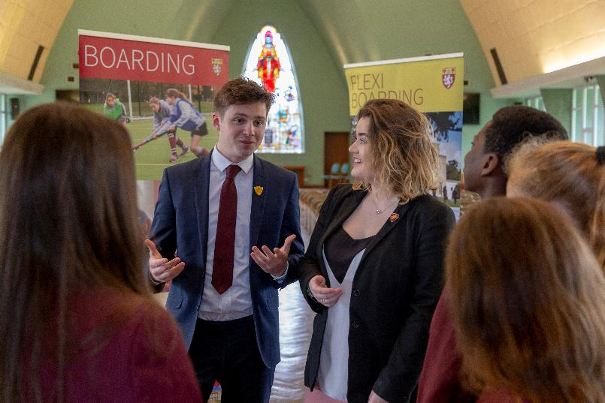
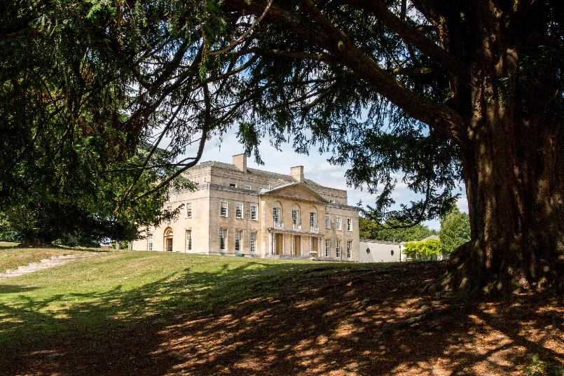
An Outstanding Sixth Form

Slide 5
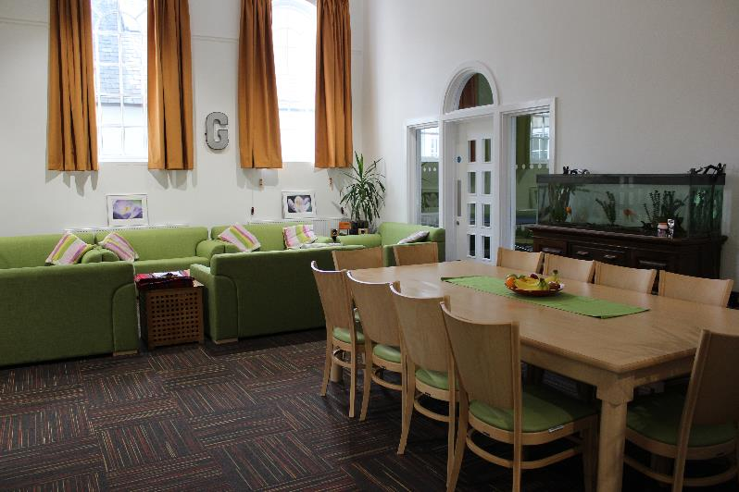
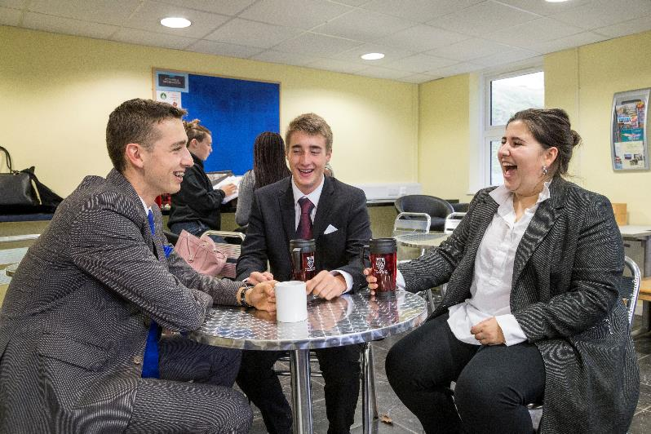
An Outstanding Sixth Form

Slide 6
An Outstanding Sixth Form
“The School provides a secure environment in
which children and young people flourish,
achieve academically, stretch their abilities and
develop social skills”
OFSTED Inspection – March 2018

Slide 7
An Outstanding Sixth Form
“The School provides a secure environment in
which children and young people flourish,
achieve academically, stretch their abilities and
develop social skills”
OFSTED Inspection – March 2018

Slide 8
An Outstanding Sixth Form
“The School provides a secure environment in
which children and young people flourish,
achieve academically, stretch their abilities and
develop social skills”
OFSTED Inspection – March 2018

Slide 9
An Outstanding Sixth Form
“The School provides a secure environment in
which children and young people flourish,
achieve academically, stretch their abilities and
develop social skills”
OFSTED Inspection – March 2018

Slide 10
An Outstanding Sixth Form
“The School provides a secure environment in
which children and young people flourish,
achieve academically, stretch their abilities and
develop social skills”
OFSTED Inspection – March 2018

Slide 11
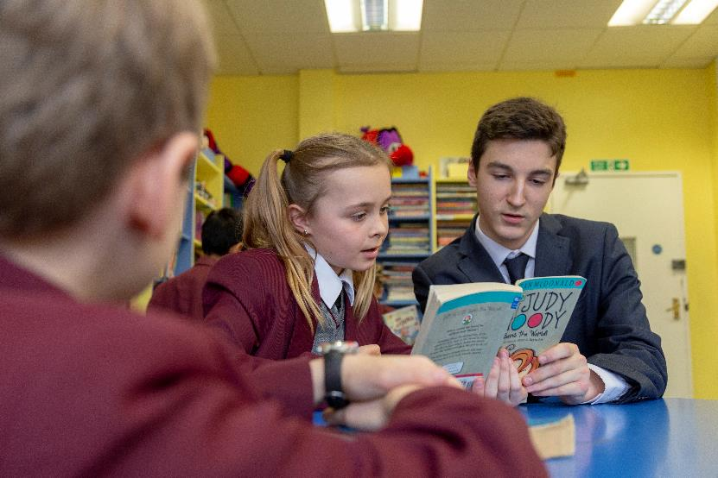
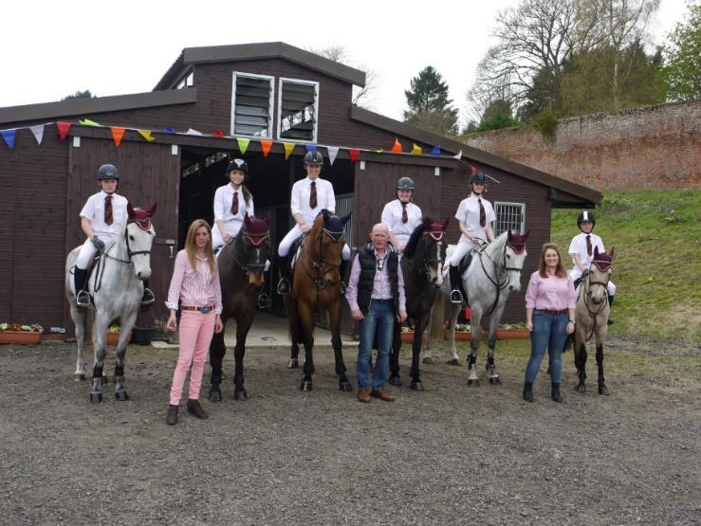
A Diverse Community

Slide 12
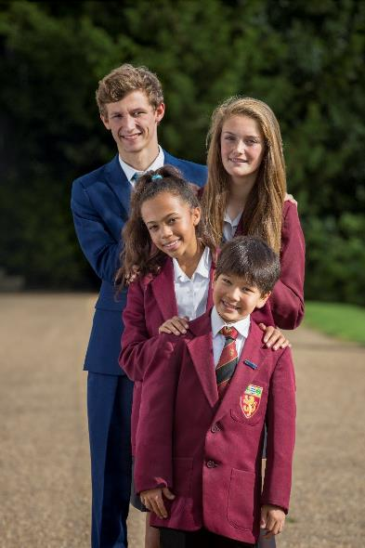
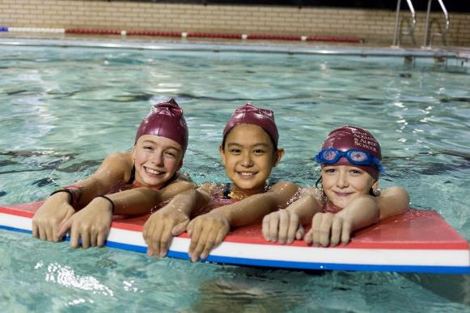
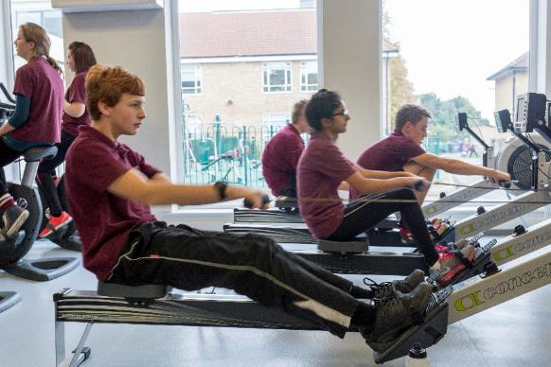
A Diverse Community

Slide 13
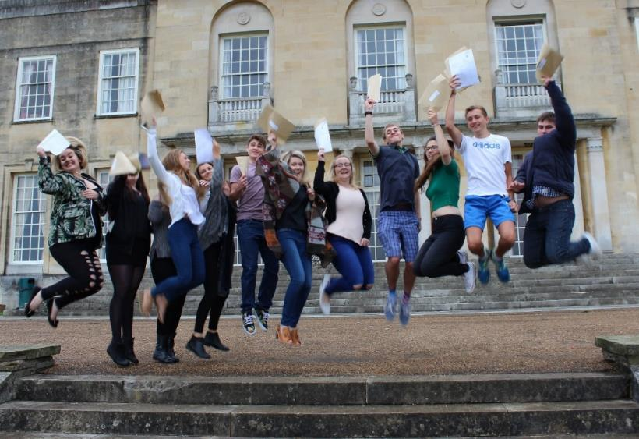
Assured Academic Results
More than half of the pupils’ grades are grade B or better
More than a quarter of the grades are A or A*

Slide 14
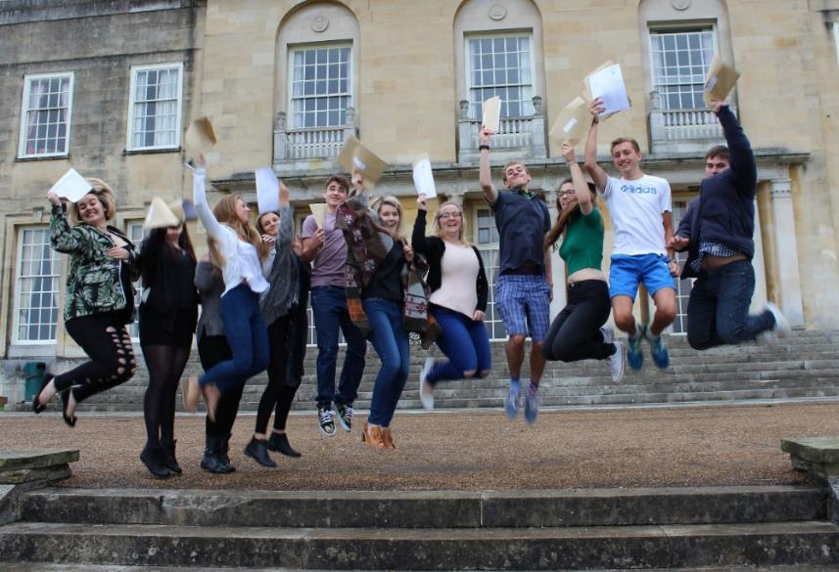
Assured Academic Results
Pupils well supported to go on to a range of good Universities for a breadth of courses

Slide 15
Assured Academic Results
In 2019 – Oxford, Cambridge, UCL, KCL, Manchester, Bristol
Plus international Universities e.g. America, Netherlands, Spain, Germany

Slide 16
Assured Academic Results
Engineering, Criminology, Psychology, Business, Chemistry, Law, Sports Science, Media, Teaching, Film, History, Economics, Archaeology and Anthropology, Journalism, Medicine, Philosophy
Degree Apprenticeships: e.g. Unilever and British Aerospace

Slide 17
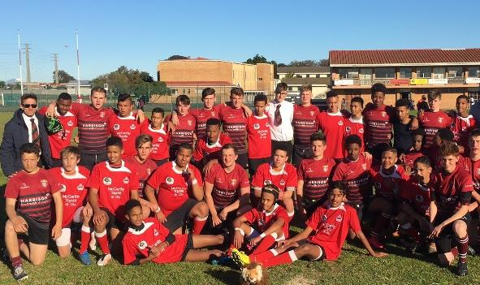
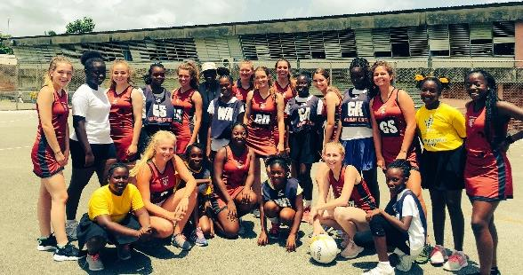
Broadened Horizons
Senior Netball Tour to Barbados
Senior Rugby Tour to South Africa

Slide 18
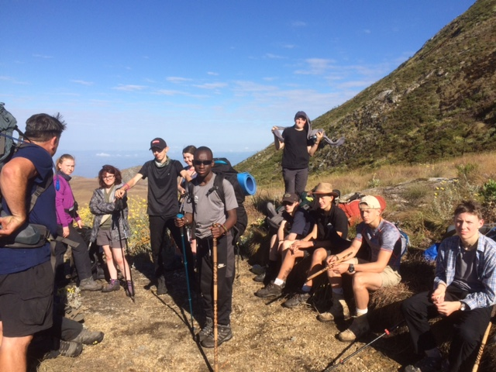
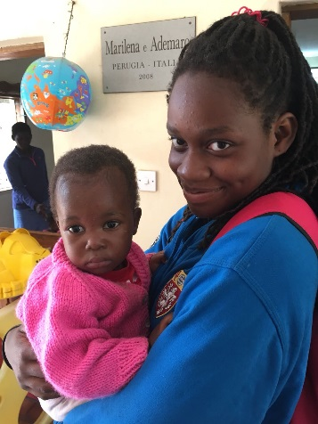
Broadened Horizons
Charitable Expedition to Malawi

Slide 19
Deputy Head (Co-Curriculum & Community)
Jo Czerpak

Slide 20
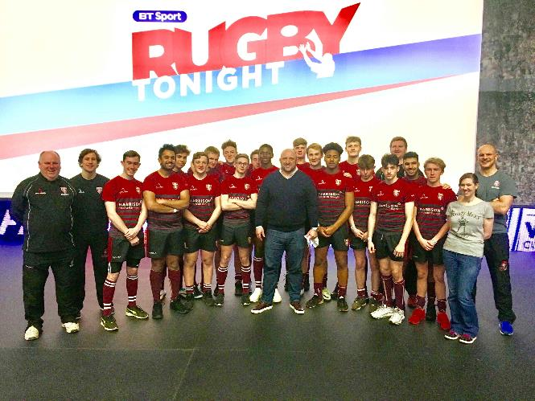
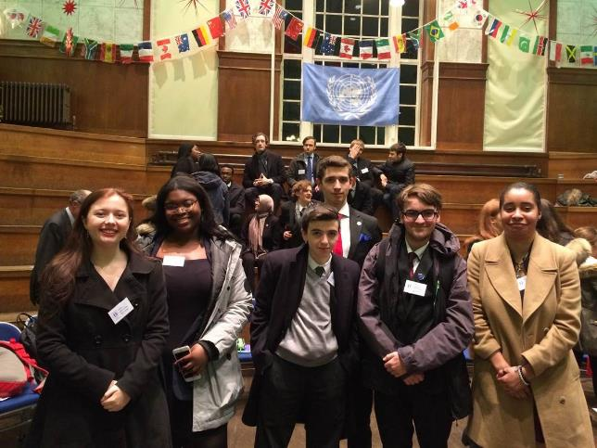
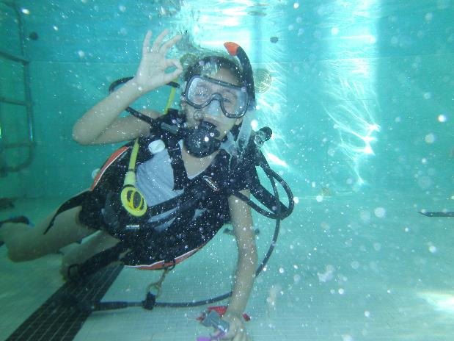
What is Co-Curriculum?

Slide 21
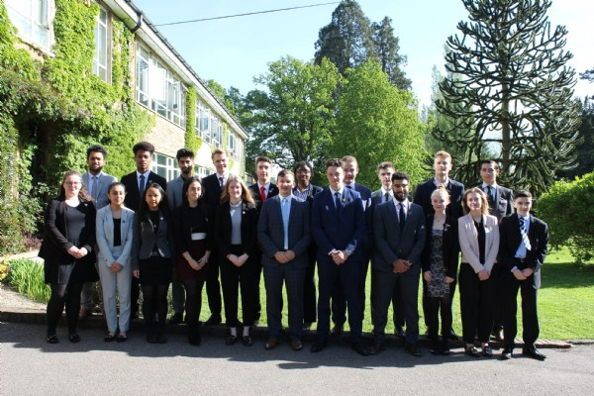
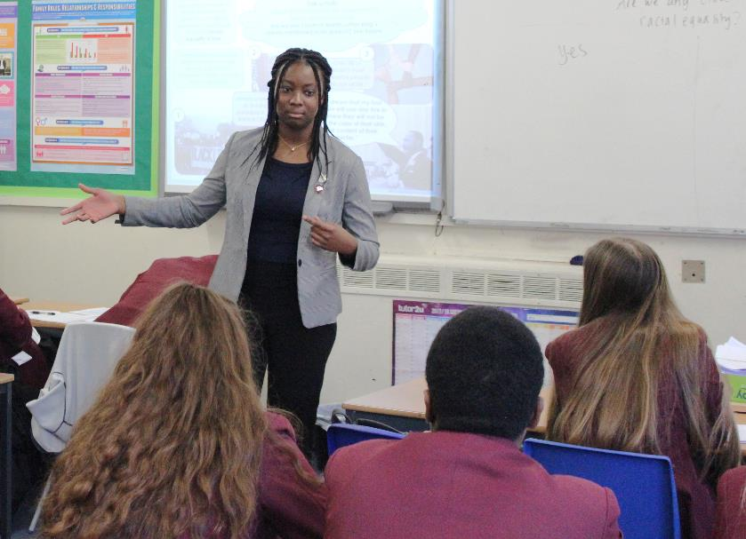
Global Leader Award

Slide 22
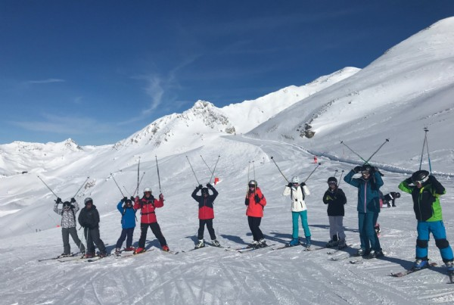
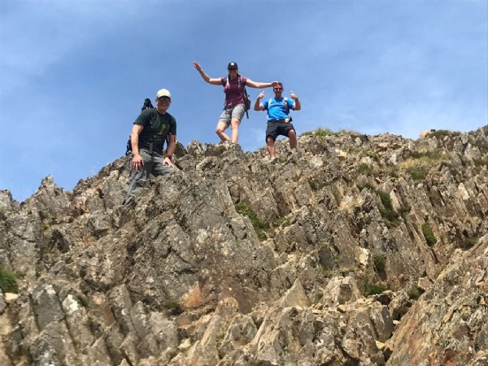
Events / trips

Slide 23
Head of Sixth Form
Tamasine Bellaby

Slide 24
What makes us special?

Slide 25
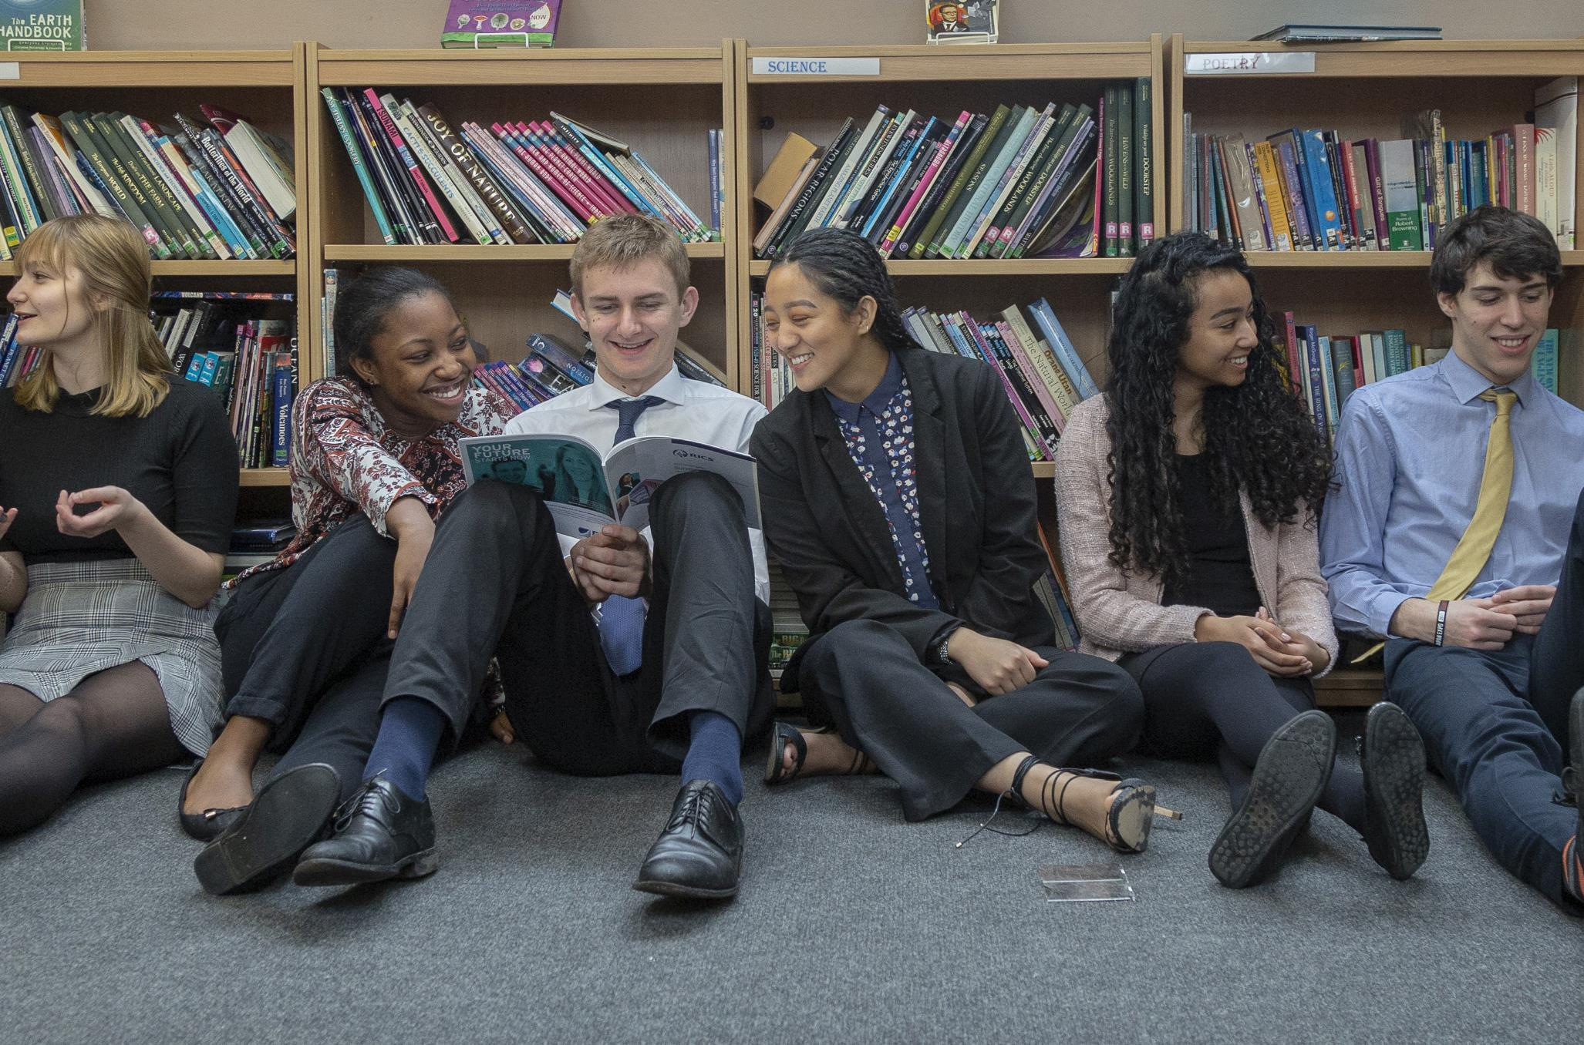

Slide 26
Subjects Offered
Art and Design
Business A Level
Business BTEC
Chemistry
Computing
Drama & Theatre Studies
Economics
English Literature
Film Studies
French
Geography
Health and Social Care BTEC
History
IT - OCR Cambridge Technical Introductory Diploma
Mathematics
Further Mathematics
Media Production (Digital) BTEC NEW
Music
Exercise and Sport Science BTEC
Physics
Politics
Product Design
Psychology
Sociology
Spanish

Slide 27
Being the best version of yourself
Every student has it within them to become the best version of themselves that they can be.
We focus on guiding students to realise this potential – whatever that means for them.

